Slide 1
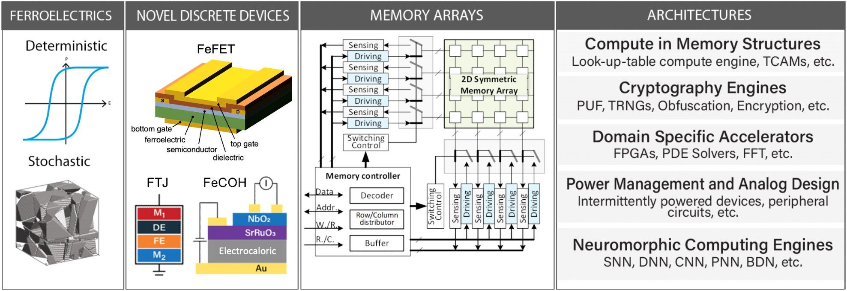







Three-Dimensional Ferroelectric Microelectronics (3DFeM)
Susan Trolier-McKinstry (Penn State); Class: 2020-2024
MISSION: 3DFeM will exploit the 3rd dimension in microelectronics for functions beyond interconnects by incorporating low-power, non-volatile ferroelectric memory. Ferroelectric materials and new devices will be co-designed, integrated reliably, and densely interconnected with logic to enable low-power, 3D non-von Neumann computation.
VISION:

Slide 2
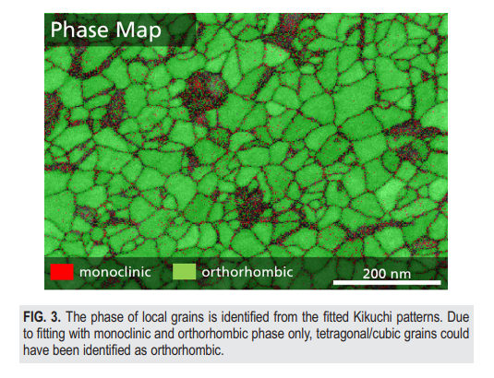
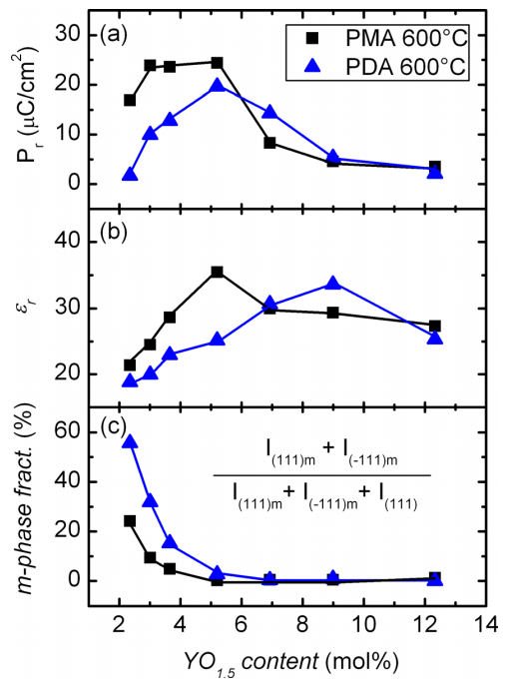

Inspiration: Random Spatial Fluctuation of Crystalline Phases in Ferroelectric HfO₂
Random FE/DE phase fluctuation
Variation of the DE phase percentage
FE: Ferroelectric
DE: Dielectric
M. Lederer et al., Appl. Phys. Lett. 115, 222902 (2019)
Random spatial fluctuation of the FE/DE phases in poly-crystalline HfO₂, especially at BEOL integration temperatures
Depending on processing conditions, various percentages of DE phases will be present in the HfO₂ thin film
J. Muller et al., J. Appl. Phys. 110, 114113 (2011)

Slide 3
Modeling Approach
Calibrated FE and underlying transistor parameters to model FeFET
Randomly assigning FE/DE grains in the thin film

Slide 4
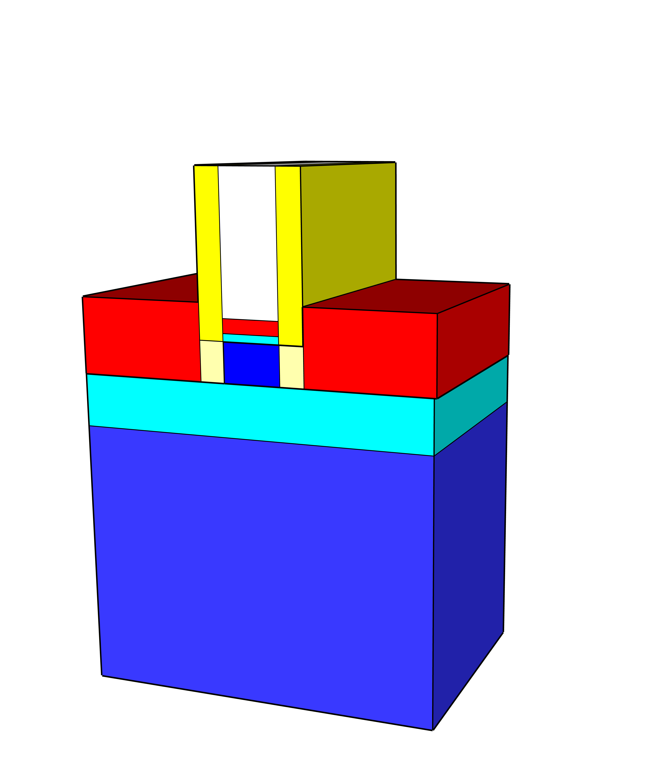
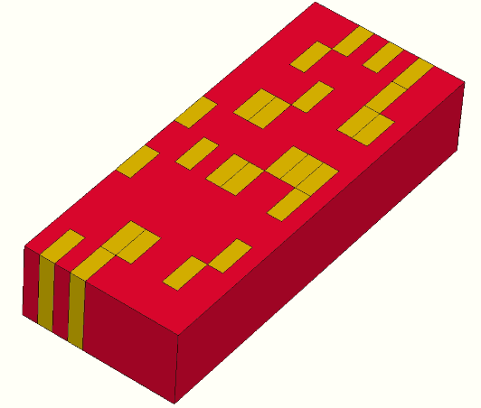
Theoretical Understanding of Random Phase Fluctuation
FeFET
Ferroelectric
Scientific Achievement
  Theoretical simulations explain the impact of random spatial fluctuation of FE/DE phases on FeFET performance.
Significance and Impact
  Clarify the impact of mixing FE/DE phases and show the robustness of FeFET against the presence of moderate DE phases, indicating the feasibility of 3D stacked FeFET memory with non-ideal FE film.
Research Details
  A versatile theoretical modeling framework to evaluate the impact of distributed parameters on the FeFET performance
  Memory window remains almost the same even with 50% DE phase
  The random location of FE/DE phases affect the forming of conduction path across channel and no channel is formed above certain DE phase percentage.
W/L=50nm/20nm
Dielectric
0% DE
L_{G}=20nm
W_{G}
90% DE
L_{G}=20nm
50% DE
L_{G}
LVT
HVT
Ferroelectric
Polarization
@V_{G}=0V after positive set
(μC/cm²)
0
Electrostatic
Potential
14
0.64
(V)
0.45
eDensity
No current path
1.5x10²⁰
(cm⁻³)
0 percent
50 percent
90 percent
100 percent
10¹⁸
The impact of random FE/DE phase fluctuation on the FeFET variation: When the domains are abundant (~100 in our study), the FeFET memory window is not significantly impacted by the presence of DE phase up to a certain percentage threshold. Beyond the threshold, FE phase islands are surrounded by DE phases and no percolation paths exist to conduct current.
Garg, Chirag, Chauhan, Nitanshu, Deng, Shan, Khan, Asif Islam, Dasgupta, Sudeb, Bulusu, Anand, and Ni, Kai, “Impact of random spatial fluctuation in non-uniform crystalline phases on the device variation of ferroelectric FET,” IEEE Electron Dev. Lett. (Under review)
Work was performed at Rochester Institute of Technology
Notes:
Ferroelectric films, for example HfO2, integrated at low temperatures compatible with the back-end-of-line processing of 3D integrated circuits, are typically poly-crystalline and there also exists random fluctuation in the crystalline phases. In HfO2, depending on the processing conditions, the orthorhombic ferroelectric (FE) phase, the monoclinic dielectric (DE) phase, and the tetragonal antiferroelectric (AFE) phase could co-exist. The impact of these random phase fluctuation on the performance, especially the device variation, of ferroelectric FET (FeFET) has not been evaluated.
Researchers at DOE’s Three-Dimensional Ferroelectric Microelectronics (3DFeM) center utilized the technology-computer aided design (TCAD) simulation tools to unravel the impact of random spatial fluctuation of the FE/DE phases on the FeFET variation. It is discovered that there exists a certain DE percentage threshold below which the increase of the DE phase does not significantly impact the device memory window and variation. Above the threshold, evident device degradation can be observed because the FE grains are isolated by the DE grains, which can no longer help form a percolation path in the low-VTH state or block the leakage path in the high-VTH state. This critical analysis would guide future device optimization and overall memory design in the 3DFeM center.

